Slide 1
Analyzing the Impact of Choice Complexity on Risk Choices
Maohua Nie
University of Basel
14.08.2023

Slide 2
Overview
Introduction
Literature
Hypotheses
Design and Procedure
General results and modelling
Discussion

Slide 3


Introduction
Decision-making tasks of varying complexity
Investing in a High-Yield Savings Account
Investing in Stock Options
Notes:
Image 1: https://becleverwithyourcash.com/club-lloyds-monthly-saver-review/
Image 2: https://www.thesenior.com.au/story/7524623/4-stock-market-tips-for-beginner-investors/

Slide 4
Literature review
complexity aversion:
people prefer simple options because they are easier to understand
Oberholzer et al., 2021: complexity decreased the choice probability of an option
However, almost no study testing the cognitive mechanism of complexity aversion
Zhao et al., (2020) found the pre-valuation bias are crucial for explaining loss aversion.

Slide 5
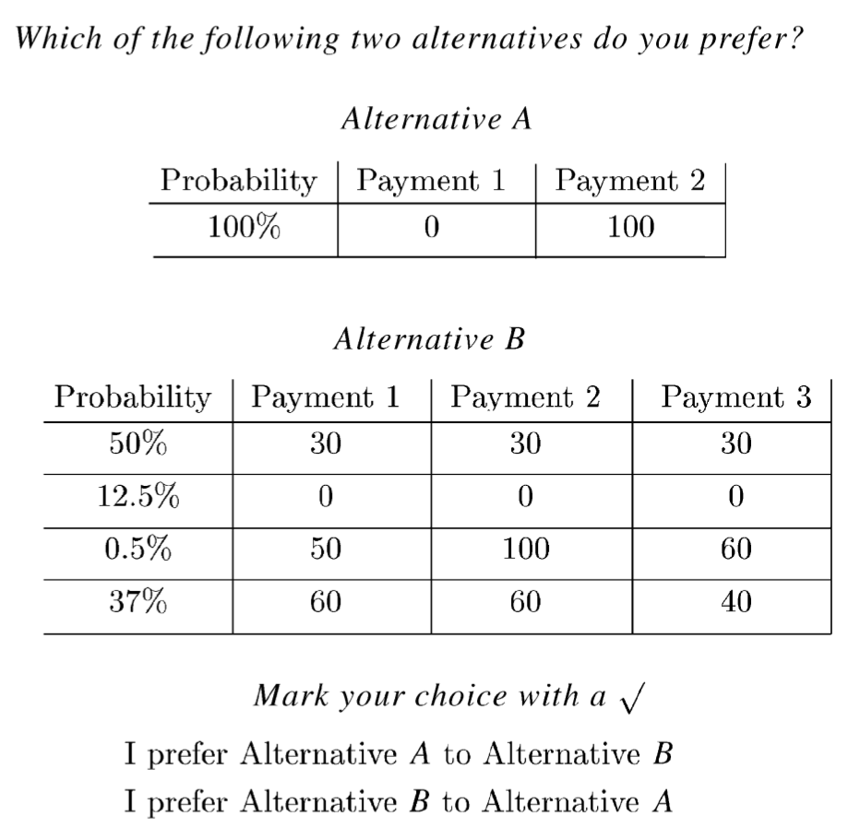
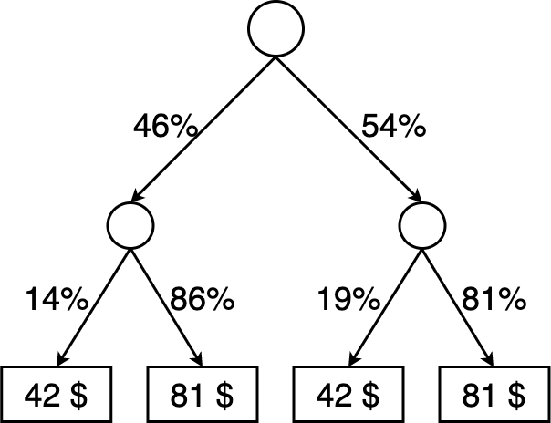
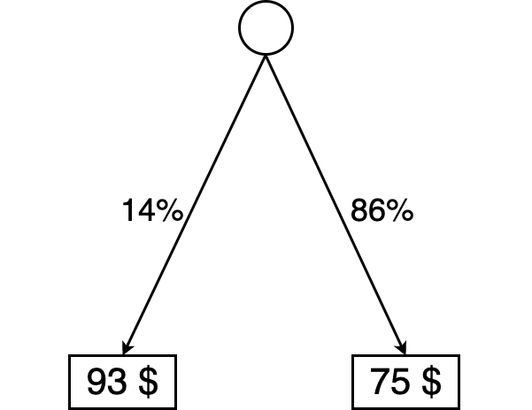
Literature review
Compound lottery (e.g., Elabed & Carter, 2015; Fan et al., 2019; Harrison et al., 2015)
Notes:
Other manipulation of comp.
Most studies focus on one type

Slide 6
Procedure
Consent form and Instruction
Description of two types of lotteries (complex and simple lotteries)
Main experiment
2 randomised blocks
After Exp
Cognitive ability test
Bonus payment decision
Demographic questions(age, education, gender and feedbacks)
simple vs. simple and complex vs. complex
complex vs. simple
3 multiple choice question to ensure the data quality (easy probability calculation tasks)
6 Practice trials to make participants familiar with real trials
Notes:
In prolific first 20 first, quality check, add another 200, if the first 20 quickly, we can inlcude this into the final dataset, if not then exclude.
Pre-reg: bold hyothesis about effect,

Slide 7
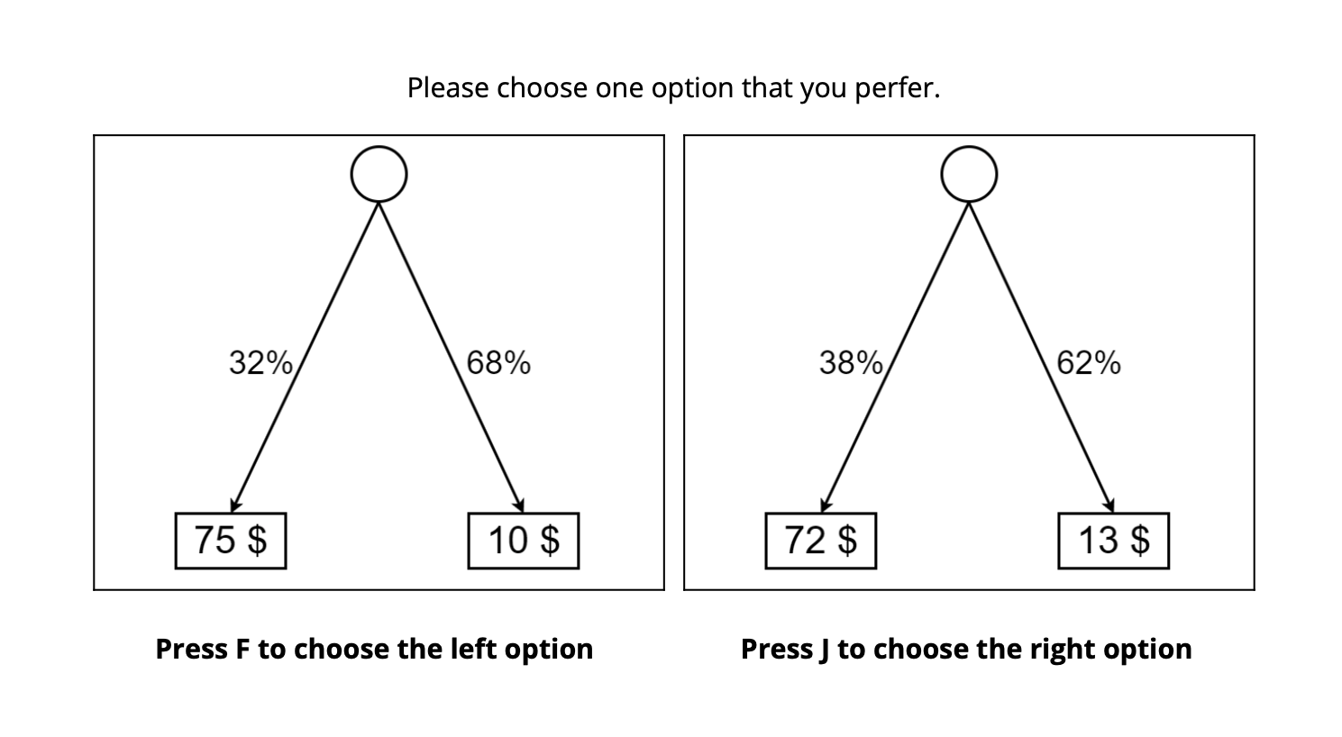
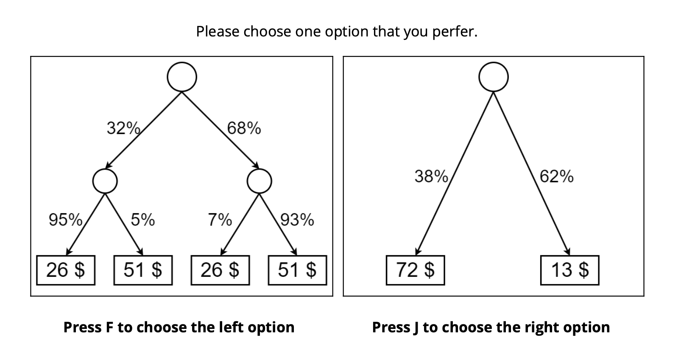
Trials
Notes:
Another hypothesis about attention, whether people pay more attention for compound or easy. Maybe use eye-tracking, not include this in pre-reg

Slide 8
Stimuli construction
EV Difference: -20,-10,0,10,20
SD Difference: 5,10, 15
Skewness diff:
left vs. right = left lottery probability of lower outcome is < .20 & right lottery probability of lower outcome is > .80
right vs. left = left lottery probability of lower outcome is > .80 & right lottery probability of lower outcome is < .20
no skew vs. no skew = left and right lottery probability of lower outcome is .30 < p < .70
8 control trials (EU Diff: 20 and -20, SD Diff 0 and no Skewness) in each condition
Notes:
for now skew: ev -20 3 sd
15 ev sd and no skew for ee, cc and ec and ce: 60
15 ev sd and lr for
For each levels: 4

Slide 9
Hypotheses in the CC and SS condition
Behavioral Hypothesis:
faster response times in simple versus simple compared to complex versus complex.
choice consistency to be higher in simple versus simple than complex versus complex

Slide 10
Hypotheses in the CS condition
Behavioral Hypothesis:
People prefer simple options than complex options.
Cognitive Mechanism hypotheses to explain complexity aversion:
First hypothesis: Complexity aversion is mainly driven by a pre-valuation bias.
Second hypothesis: Complexity aversion is mainly driven by a discounting effect that occurs during information accumulation.
Third hypothesis: Complexity aversion is mainly driven by the subjective representation of outcome probabilities.

Slide 11
Additional Correlation Hypotheses
Behavioral Hypothesis:
Complexity aversion is positively correlated with cognitive ability.

Slide 12
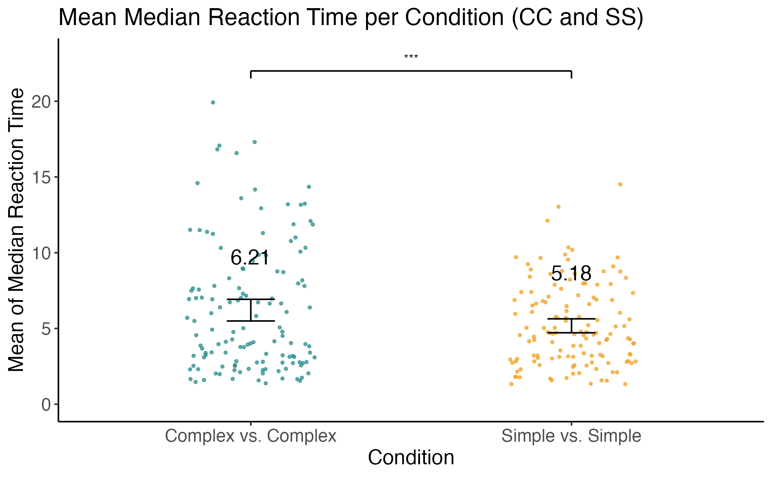
Results: Complex vs. Complex and Simple vs. Simple: Reaction time
faster RT in the CC condition (t(131) = 5.8352, p < .005)

Slide 13
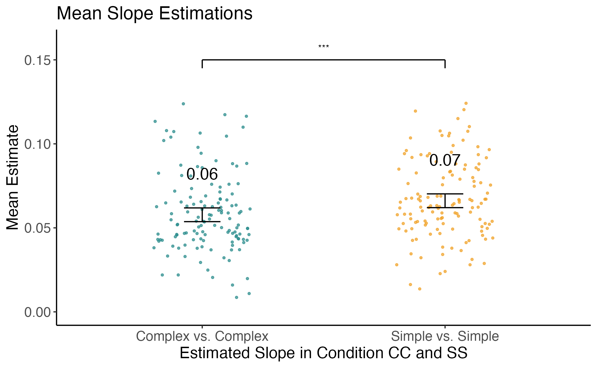
Results: Complex vs. Complex and Simple vs. Simple: EV Coefficient
t test comparing Coefficient of EV in a logistic regression on choice in CC and SS condition(higher in the SS condition, t(131) = -4.534, p < .005)

Slide 14
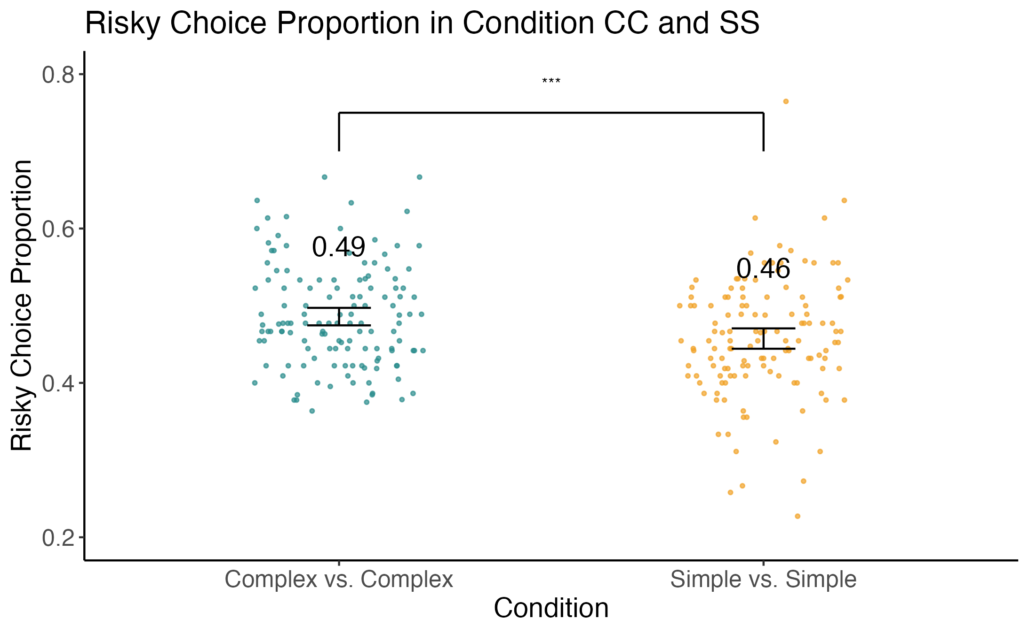
Results: Complex vs. Complex and Simple vs. Simple: Risky choices proportion
Two-sample t test comparing percentage of risky choices
More risky choices in the CC condition, t(131) = -3.50, p < .005

Slide 15
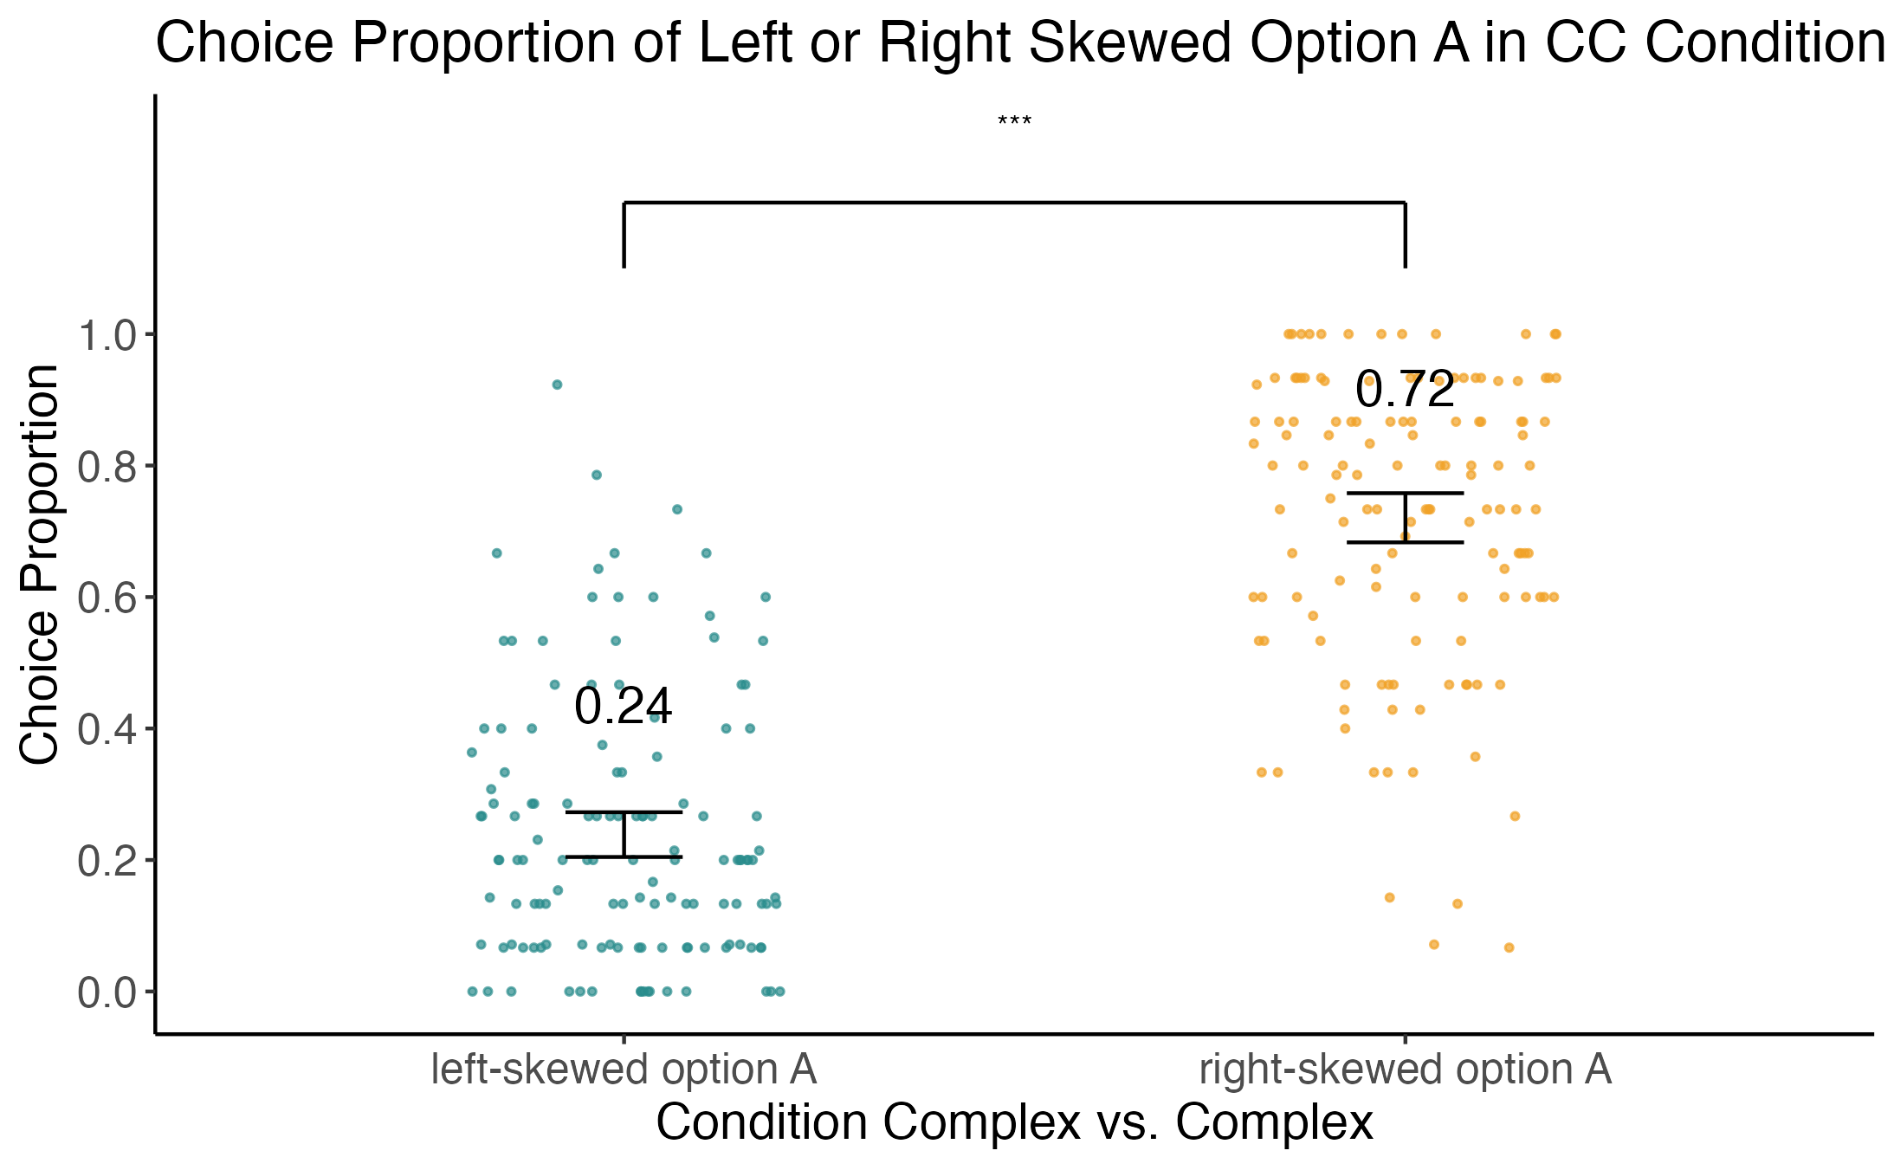
Results: Complex vs. Complex and Simple vs. Simple: Skewness in CC
In CC condition: right skewed option A was prefered. t(131) = 13.93, p < .005

Slide 16
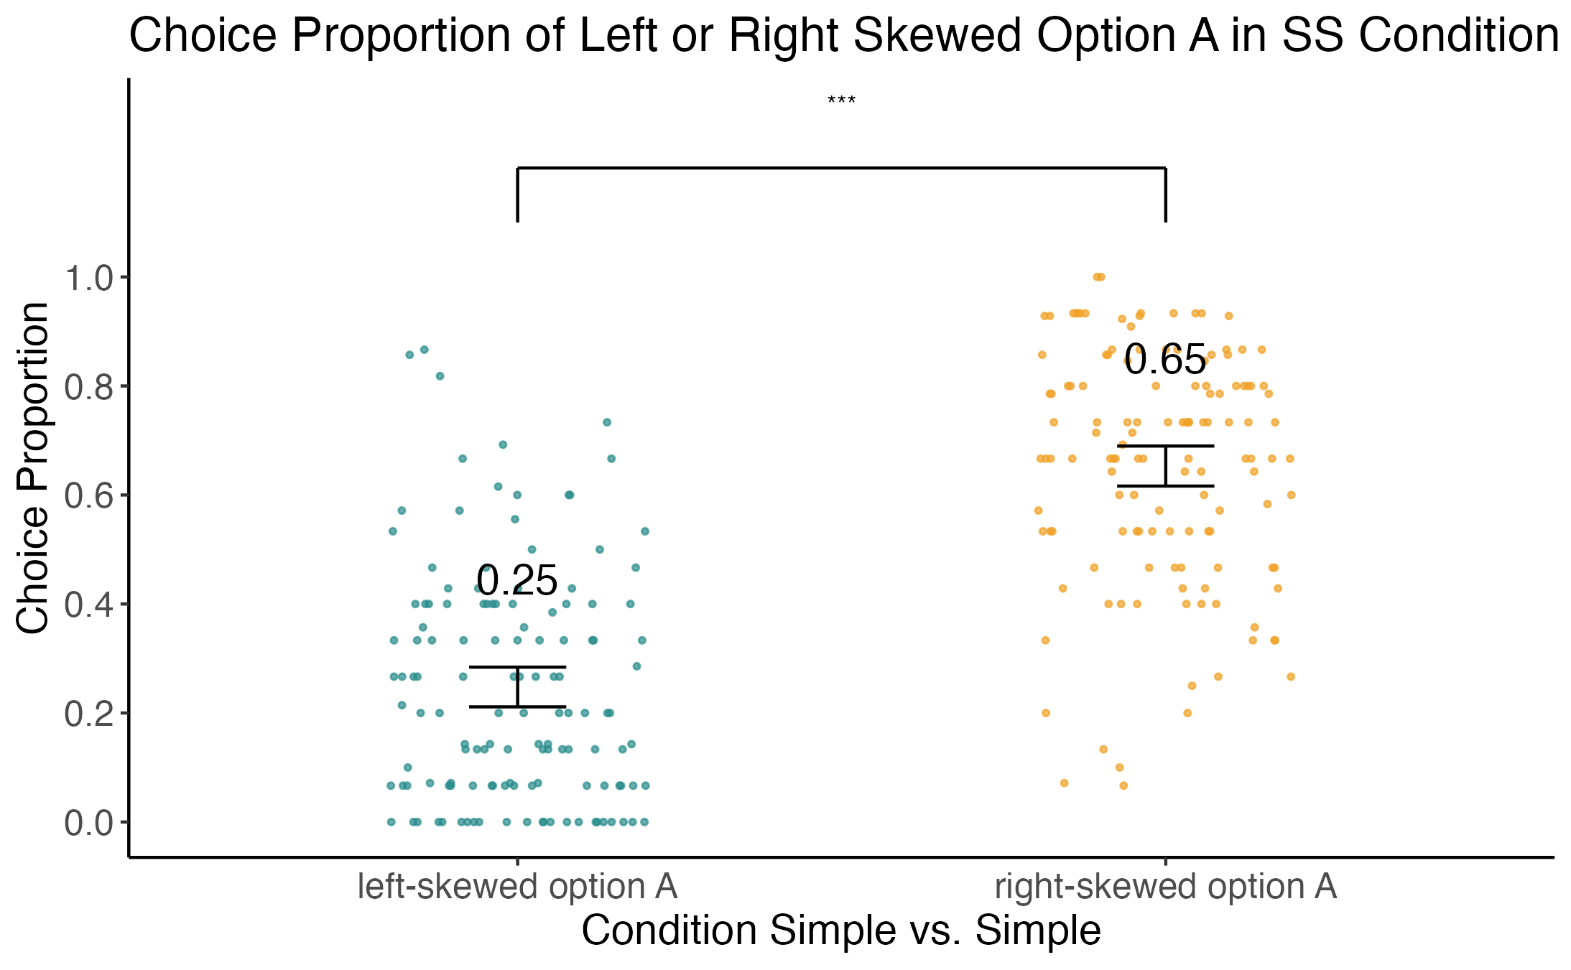
Results: Complex vs. Complex and Simple vs. Simple: Skewness in SS
In SS condition: right skewed option A was prefered. t(131) = 12.09, p < .005

Slide 17
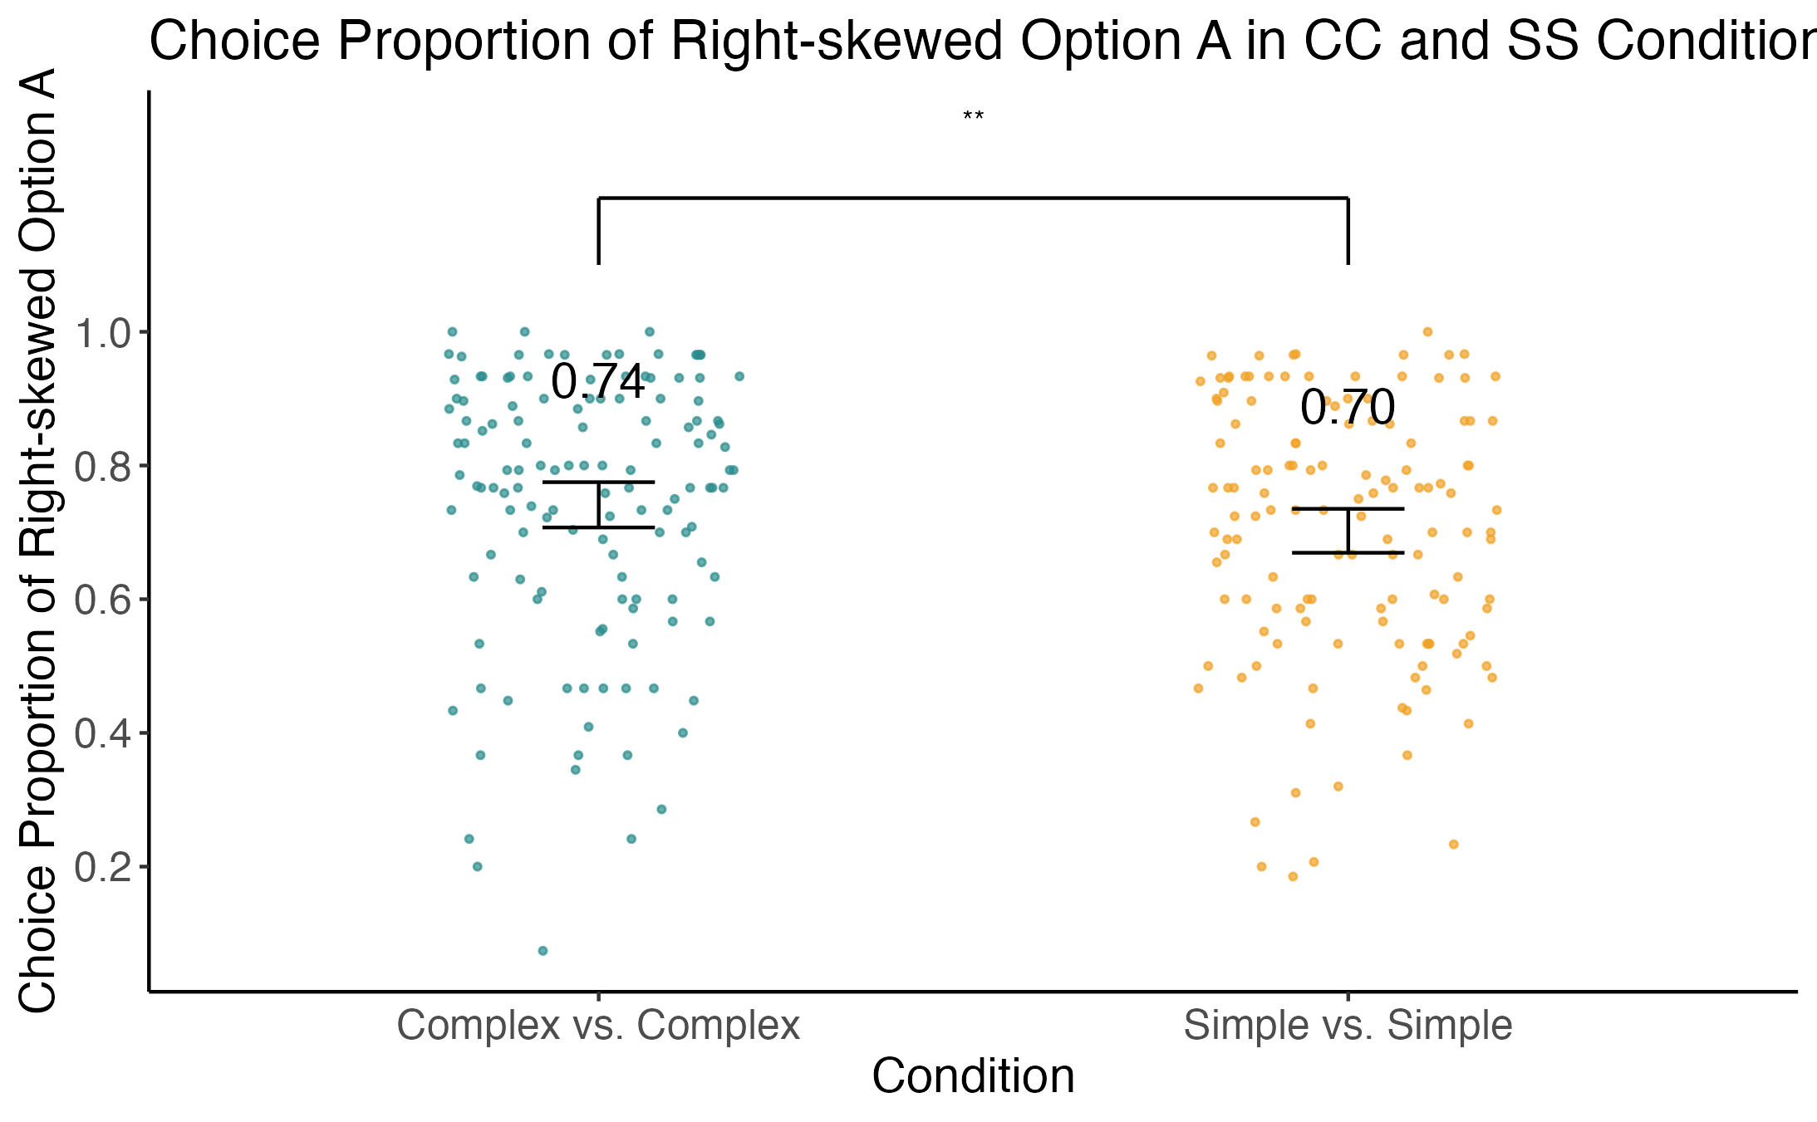
Results: Complex vs. Complex and Simple vs. Simple: Skewness in CC and SS
Right-Skewed Option A was more prefered in CC condition, t(131) = 2.38, p < .05

Slide 18
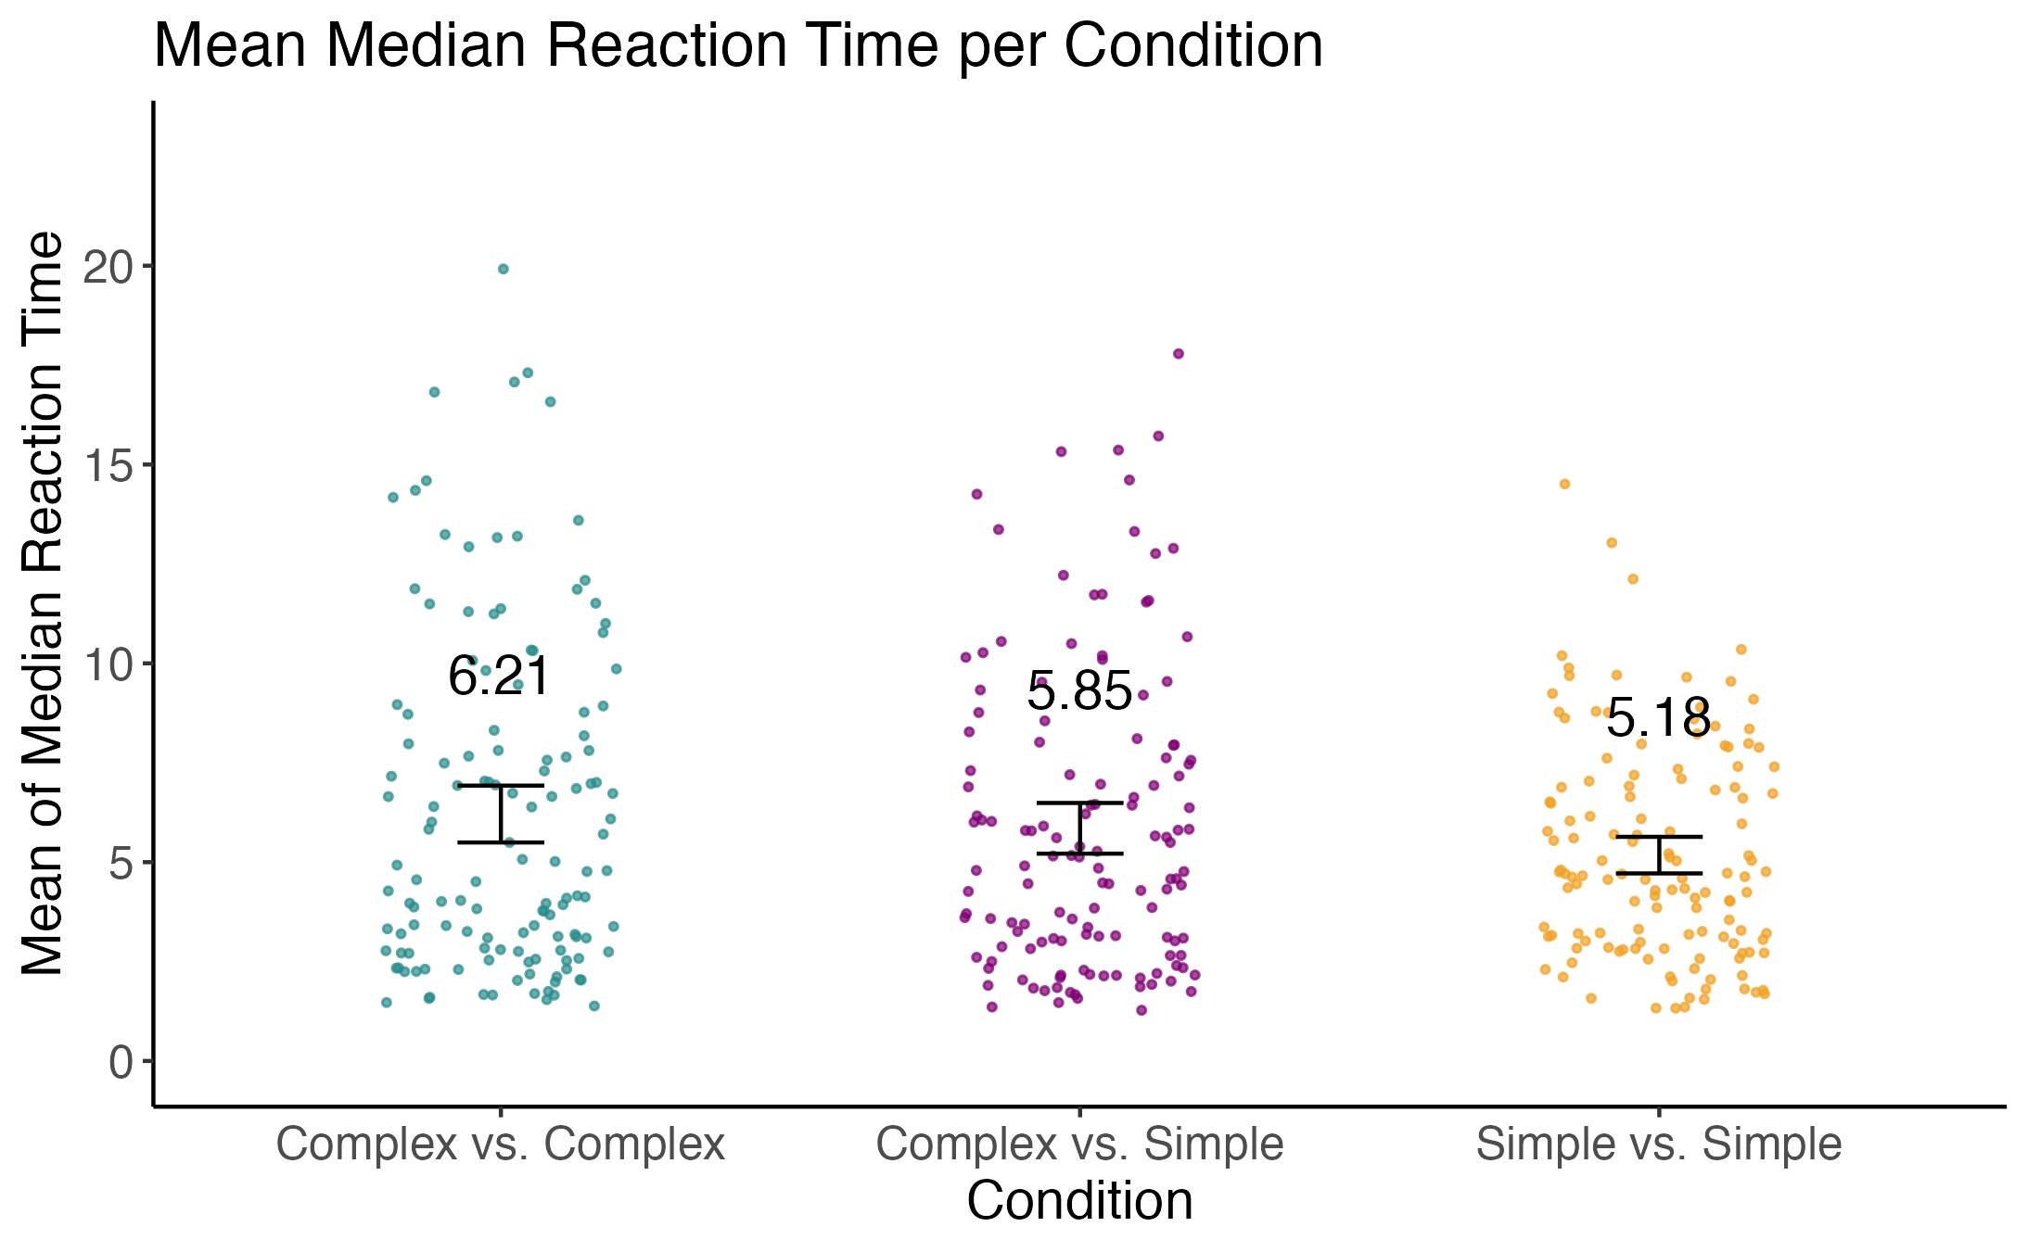
Complex vs. Simple: Reaction time

Slide 19
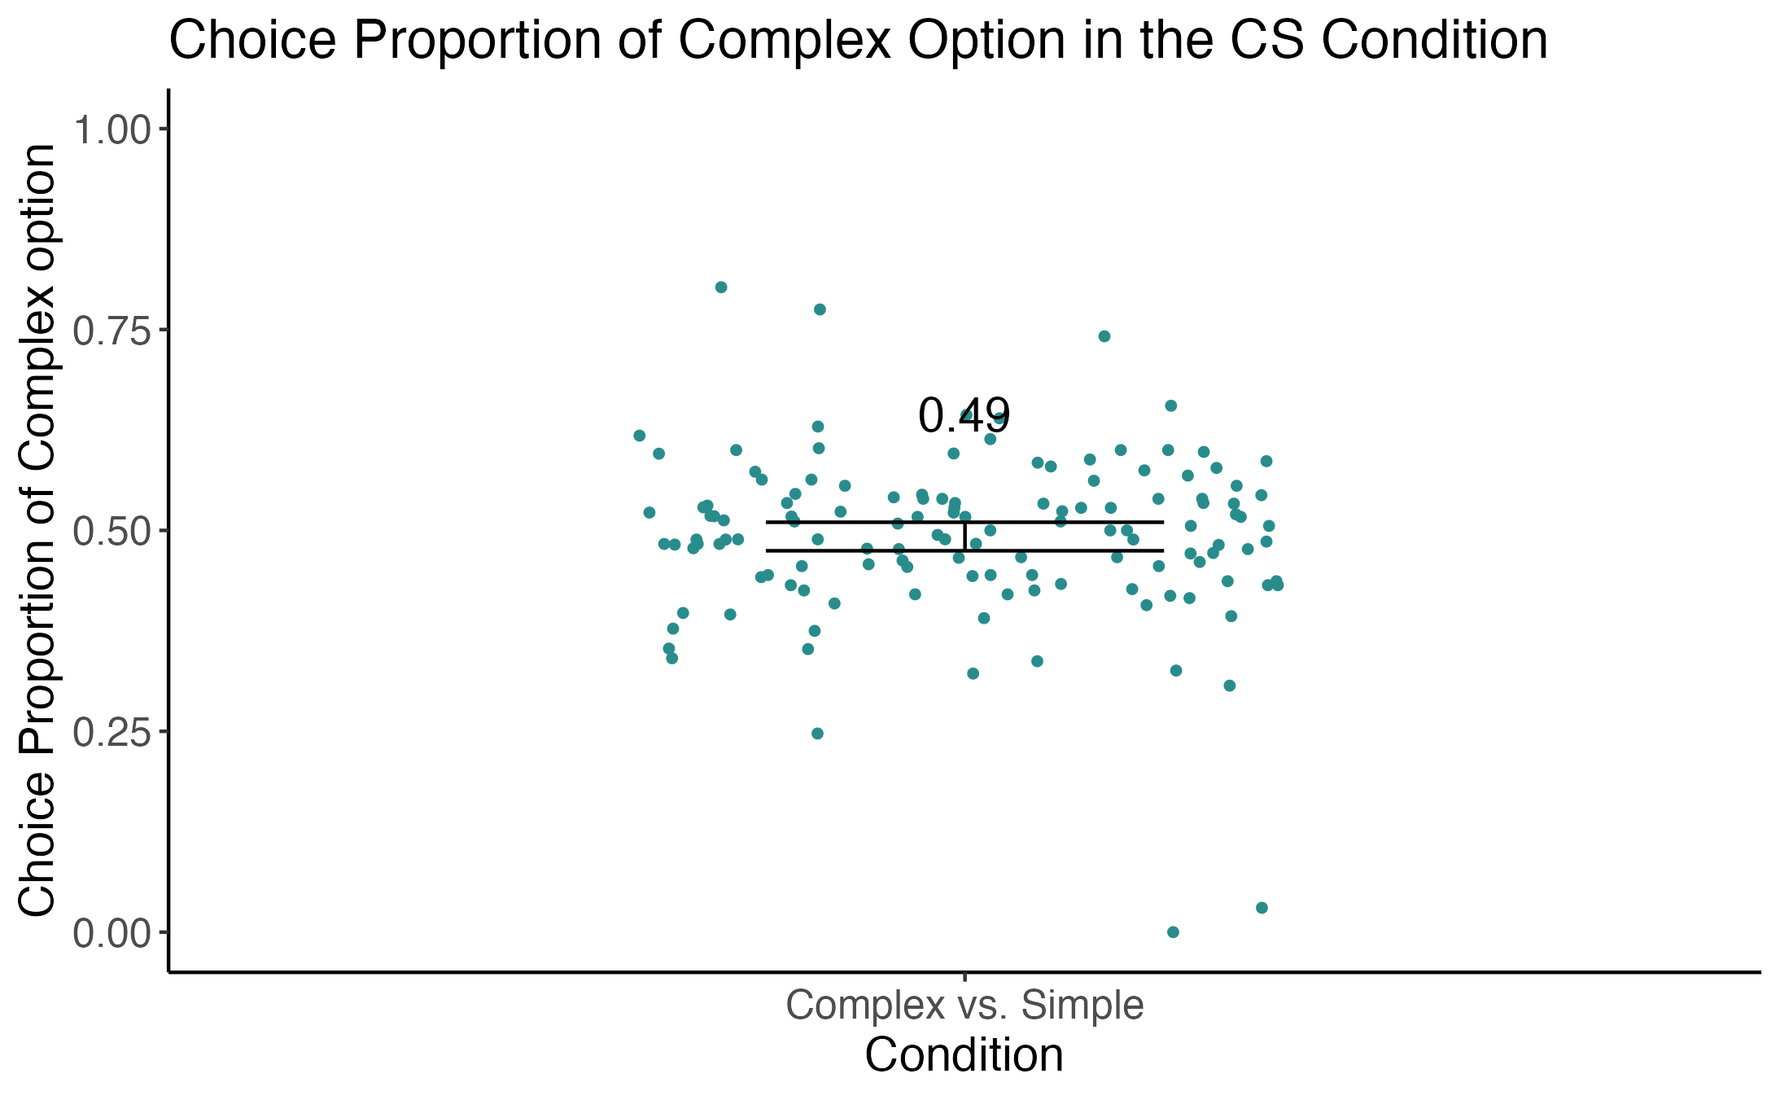
Complex vs. Simple: Choice Proportion
Not significantly lower than 50%, t(131) = -0.839, p > .05

Slide 20
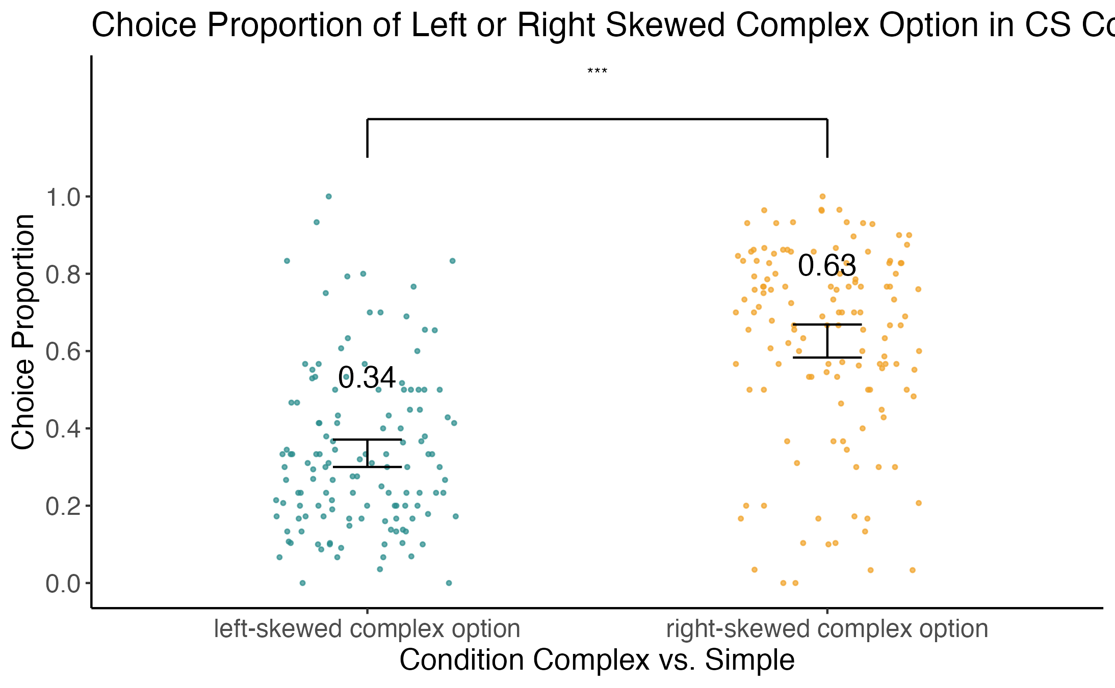
Complex vs. Simple: Skewness
In CS condition: right skewed complex option was prefered. t(131) = 8.41, p < .005

Slide 21
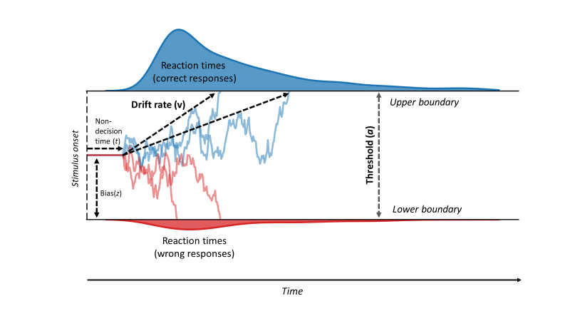
Modelling
Drift diffusion model
CC and SS condition
CS condition
risky option
complex option
safe option
simple option
Notes:
https://www.researchgate.net/figure/Illustration-of-a-drift-diffusion-model-DDM-to-model-reaction-times-in-two-choice_fig2_329577163

Slide 22
Modelling: EU and MV models
EU models: drift rate as the difference of subjective utility of the two gamble options
mean-variance models: drift rate predicted by EVD and SDD.
Model parameters for all models include: t (non-decisional time), α (choice boundary), v (drift rate), θ (choice consistency parameter), β (risk sensitivity parameter).

Slide 23
Modelling: additional parameters
CC and SS condition
∆β (risk sensitivity difference between CC and SS)
Probability weighting models: γ (curvature of probability weighting function; separate for CC and SS condition)
Threshold models: λ
CS condition
Starting point models: z (starting point, 0 if neutral)
Discounting effect models: η (complexity discounting)
Probability weighting models: γ (curvature of probability weighting function; separate for simple and complex)

Slide 24
Modelling: Results in CC and SS
CC and SS condition
risk sensitivity difference between CC and SS
strictly negative 95% credible interval excluded 0 in both EU and MV models
higher consistency for simple versus simple compared to complex versus complex.
EU: mean: -0.32, 95% HPDI: (-0.48, -0.21)
MV: mean: -0.003, 95% HPDI: (-0.0035, -0.002)

Slide 25
Modelling: Results in CC and SS
CC and SS condition
Threshold λ
strictly positive 95% HPDI excluded 0 in both EU and MV models
larger threshold of complex versus complex compared to simple versus simple.
EU: mean: 0.20, 95% HPDI: (0.12, 0.27)
MV: mean: 0.19, 95% HPDI: (0.12, 0.27)

Slide 26
Modelling: Results in CC and SS
CC and SS condition
Probability weighting models: γ (curvature of probability weighting function; separate for CC and SS condition)
EU: mean: -0.25, 95% HPDI: (-0.39, -0.11)
MV:

Slide 27
Modelling: Results in CS
CS condition
Starting point models: 95% HPDI included 0.5 in both EU and MV models, no evidence support preliminary disposition against complex options
Discounting effect models: 95% HPDI included 0 in both EU and MV models, no evidence support discounting effect against complex options
Probability weighting models:

Slide 28
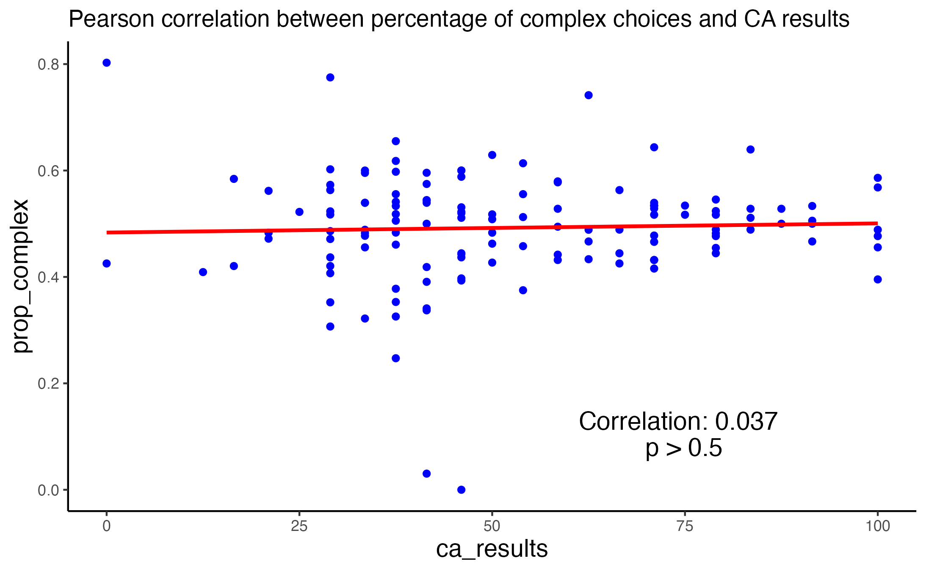
Correlation between cognitive ability and complexity aversion
No significant correlation between cognitive ability scores and choice proportion of complex option in the CS condition.

Slide 30
Thanks for your attention!
Reference:
Iyengar, S. S., & Kamenica, E. (2010). Choice proliferation, simplicity seeking, and asset allocation. Journal of Public Economics, 94(7), 530–539. https://doi.org/10.1016/j.jpubeco.2010.03.006
Kovářík, J., Levin, D., & Wang, T. (2016). Ellsberg paradox: Ambiguity and complexity aversions compared. Journal of Risk and Uncertainty, 52(1), 47–64. https://doi.org/10.1007/s11166-016-9232-0
Sonsino, D., & Mandelbaum, M. (2001). On Preference for Flexibility and Complexity Aversion: Experimental Evidence1. Theory and Decision, 51(2), 197–216. https://doi.org/10.1023/A:1015555026870
Elabed, G., & Carter, M. R. (2015). Compound-risk aversion, ambiguity and the willingness to pay for microinsurance. Journal of Economic Behavior & Organization, 118, 150–166. https://doi.org/10.1016/j.jebo.2015.03.002
Fan, Y., Budescu, D. V., & Diecidue, E. (2019). Decisions with compound lotteries. Decision, 6(2), 109–133. https://doi.org/10.1037/dec0000091
Harrison, G. W., Martínez-Correa, J., & Swarthout, J. T. (2015). Reduction of compound lotteries with objective probabilities: Theory and evidence. Journal of Economic Behavior & Organization, 119, 32–55. https://doi.org/10.1016/j.jebo.2015.07.012
Oberholzer, Y., Olschewski, S., & Scheibehenne, B. (2021). Complexity Aversion in Risky Choices and Valuations: Moderators and Possible Causes. PsyArXiv. https://doi.org/10.31234/osf.io/tnvzr
Vinding, M. C., Lindeløv, J. K., Xiao, Y., Chan, R. C. K., & Sørensen, T. A. (2021). Volition in prospective Memory: Evidence against differences between free and fixed target events. Consciousness and Cognition, 94, 103175. https://doi.org/10.1016/j.concog.2021.103175

